Slide 1
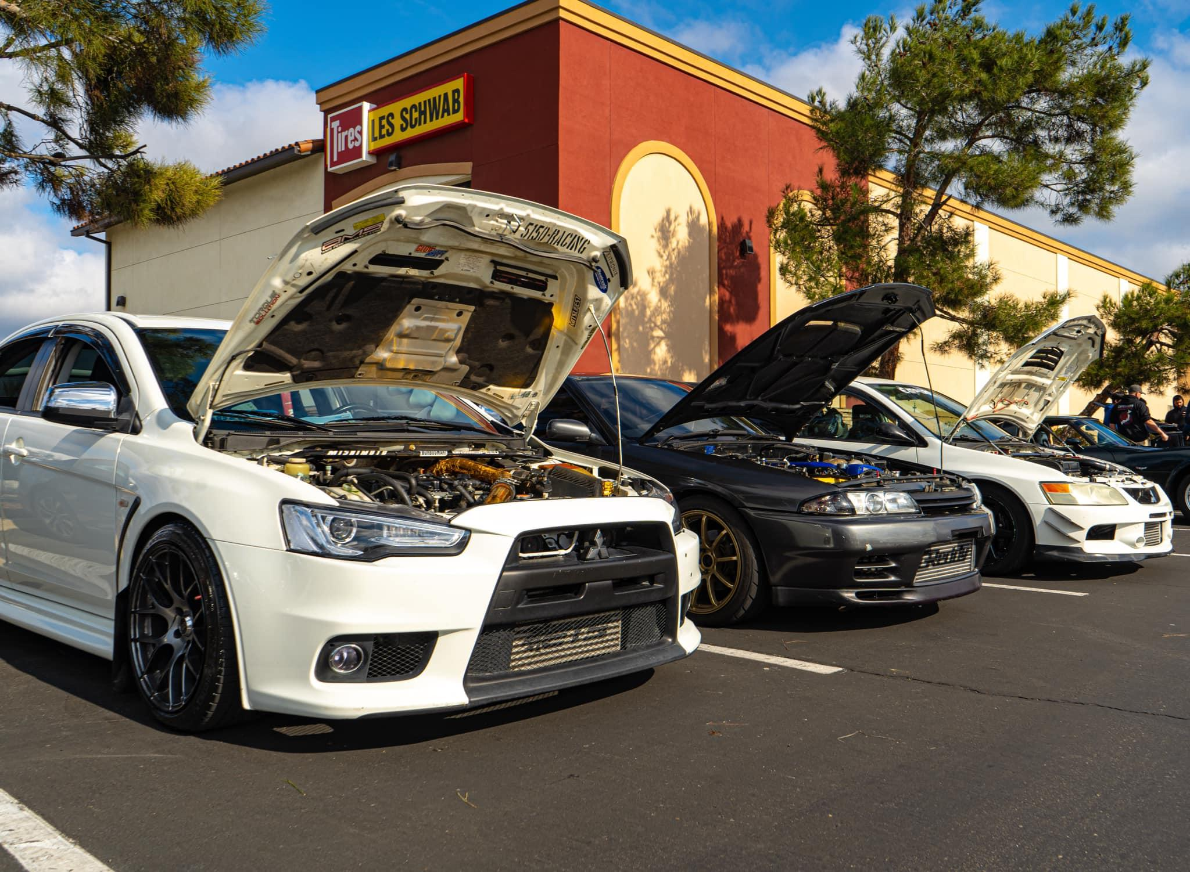
The Modern DIY Automotive Forum
By: Dylan McCallum

Slide 2
Topic Introduction
Every day, we lose valuable information in the automotive DIY (Do-It-Yourself) space because older forum websites shut down due to either lack of engagement, legacy code, or easy-to-use platforms such as Facebook or Instagram. Even though Facebook, Instagram, and other platforms provide a means to share repairs, modifications, and resources to achieve the same results, they lack detailed information about the quirks and characteristics of getting to know your vehicle or finding information and guides on performing specific repairs.

Slide 3
Topic Introduction Cont.
This is more evident when restoring classic cars where some of the older technology (some still being produced today in the aftermarket) and methods, tricks, and techniques are slowly becoming more obscure until they become permanently lost. I chose this topic and why it interests me so much because I am an automotive enthusiast. I often search countless forums, saving them, only to come back sometime soon to find the website no longer exists.

Slide 4
Why I Chose This Topic
I chose this topic and why it interests me so much because I am an automotive enthusiast. I often search countless forums, saving them, only to come back sometime soon to find the website no longer exists.

Slide 5
Solution Overview
My solution to alleviate this information shortfall is to develop a program that utilizes various web scrapers and APIs (Application Programming Interface) to collect data from multiple forum webpages, social media pages, automotive pages, and streaming pages whenever a user queries specific information on how to complete a repair or find solutions for their particular vehicle. This program will also create a copy of the information and store it in a database for safekeeping.

Slide 6
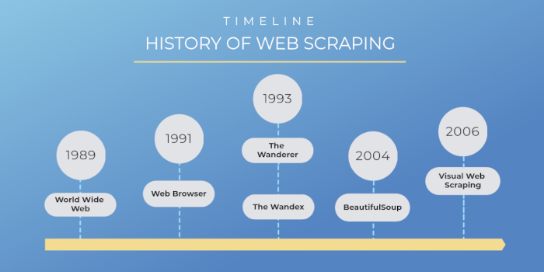
Web Scraping History And Timeline
The birth of the World Wide Web became responsible for three critical essential features that set the standard for every web scraping tool known today.
The URLs which we now use to designate a scraper to a specific website
Embedded hyperlinks that allow us to navigate through the designated website
Web pages that contained various types of data - text, images, audios, videos, etc

Slide 7
Web Scraping History Cont
The technology responsible for the foundations of Google, Bing, Yahoo, and others gave birth to JumpStation, the first web crawler-based web search engine. It was responsible for indexing millions of web pages, which helped turn the Internet into an open-source platform.

Slide 8
Summary Of Findings
The primary resources and software solutions already available are the abundance of web scrapers and APIs. Web scrapers are designed to extract data from websites by automating the process of visiting web pages, retrieving content, and parsing information. An API is a set of rules and protocols that allow different applications and programs to communicate with each other. Facebook, Reddit, Youtube, etc provide documentation on interacting with their APIs, while services such as Oxylabs provide readily available web scraping tools to fit the project's demands.

Slide 9
Summary Of Findings Cont
Depending on the desired outcome, you can implement various methods of web scraping. Methods include Traditional copy-and-paste, HTML Parsing, DOM (Document Object Model) Parsing, HTML DOM, and many others. Traditional copy-and-paste, for example, involves a user browsing the page and then manually copying and pasting that page onto other media. This method, however, is very ineffective and time-consuming.

Slide 10
Summary Of Findings Cont
On the other hand, the HTML DOM method employs computer languages, usually JavaScript, to access the objects. JavaScript can access all of the elements in an HTML utilizing the DOM. HTML DOM also possess the capabilities for altering and editing HTML elements. This method should allow me to adjust the HTML elements from older webpages to conform to the updated output for the project.

Slide 11
Summary Of Findings Cont
Python also has a few libraries and frameworks suitable for web scraping. Some of those technologies include BeautifulSoup, Scrapy, and Selenium. Each has pros and cons depending on the desired outcome required and project expectations. For this project, I would consider using Scrapy due to its extensibility to larger projects, flexible ecosystem, and rapid performance.

Slide 12
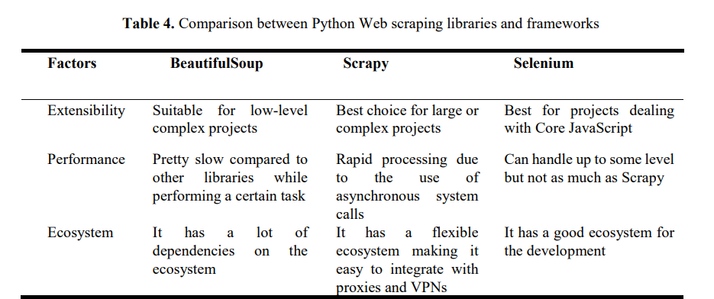
Python Frameworks Comparison

Slide 13
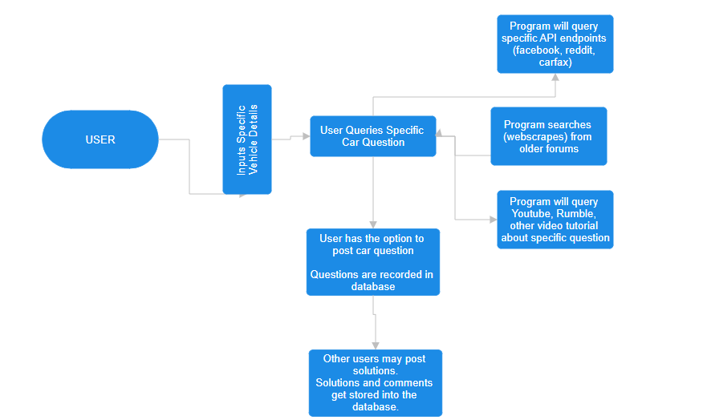
Basic User Interaction

Slide 14
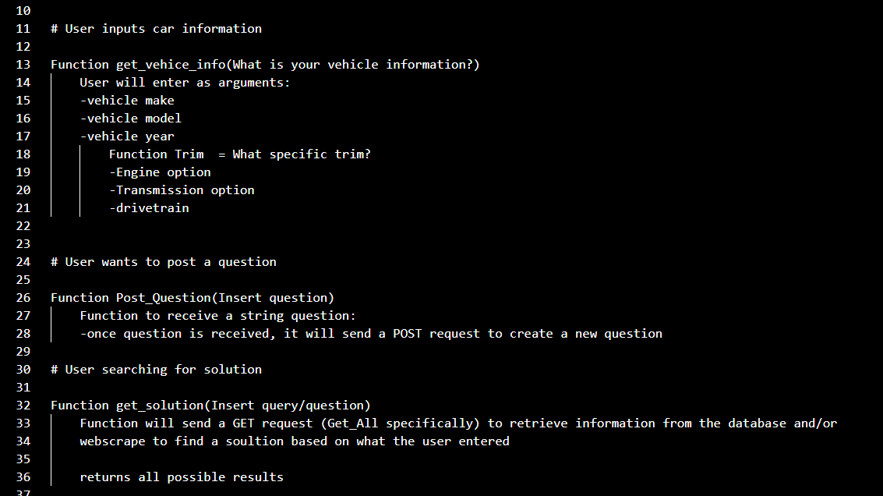
Pseudocode w/ HTTP Requests

Slide 15
Citations
https://www.researchgate.net/publication/367719780_Web_Scraping_Techniques_and_Applications_A_Literature_Review
https://webscraper.io/blog/brief-history-of-web-scraping
https://scrapy.org/
https://www.selenium.dev/documentation/webdriver/
https://pypi.org/project/beautifulsoup4/

